Slide 1

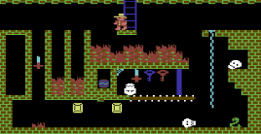
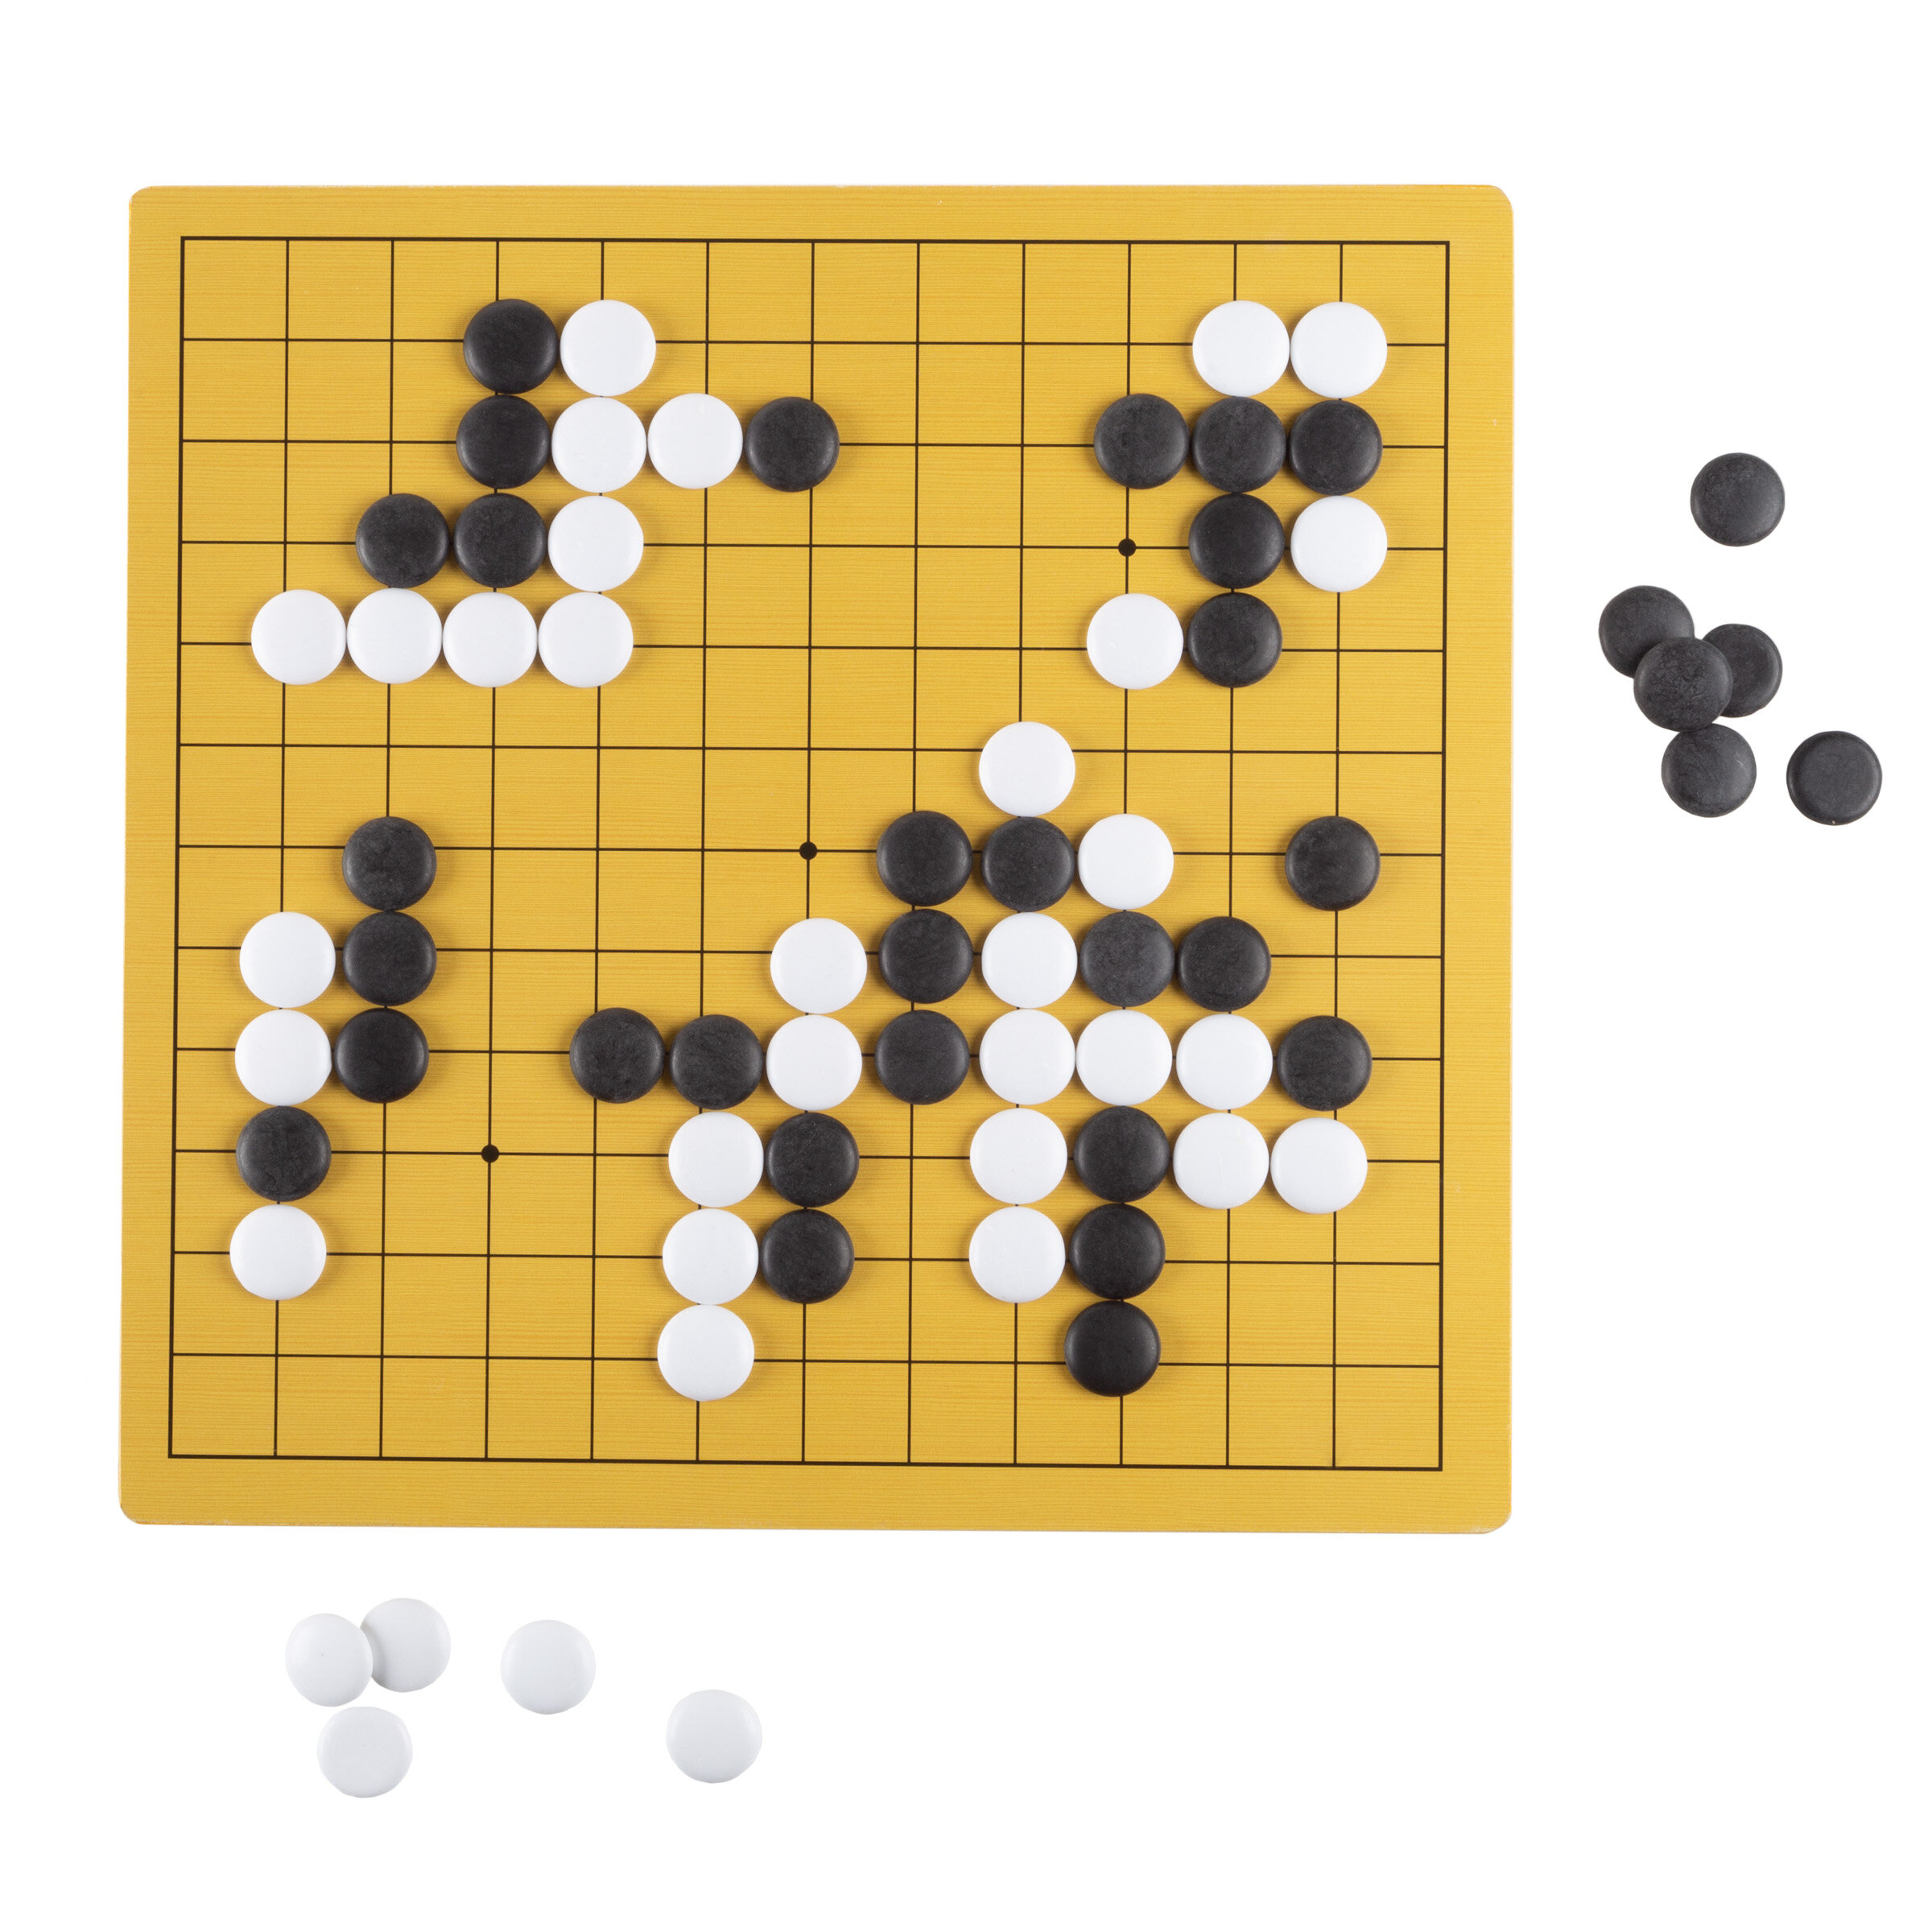
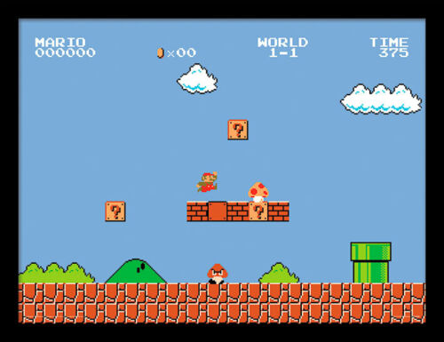
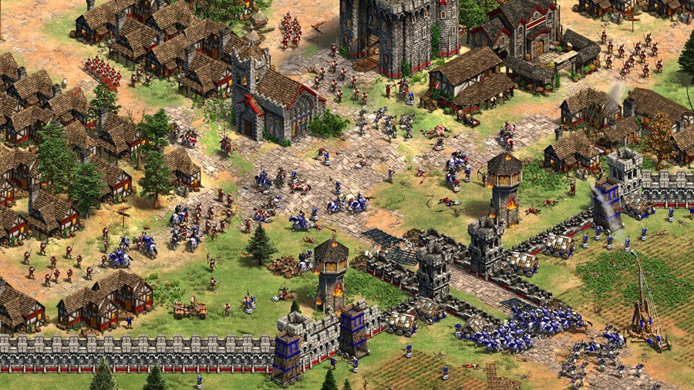
Game AI Programming
Part one - Based on Prof. Horst Eidenberger`s Leture on Strategy Game Programming @TU Vienna
Part two based on David Silvers slides and Lectures, at al.

Slide 2
Agenda
Traditional Game AI Algorithms
Minimax algorithm
Alpha Beta Pruning
Monte Carlo Tree Search
Reinforcement Learning
Value Methods
Policy Methods
Microsoft Offerings
Deep Reinforcement Learning (RL) with Azure ML
Data Science VM

Slide 3
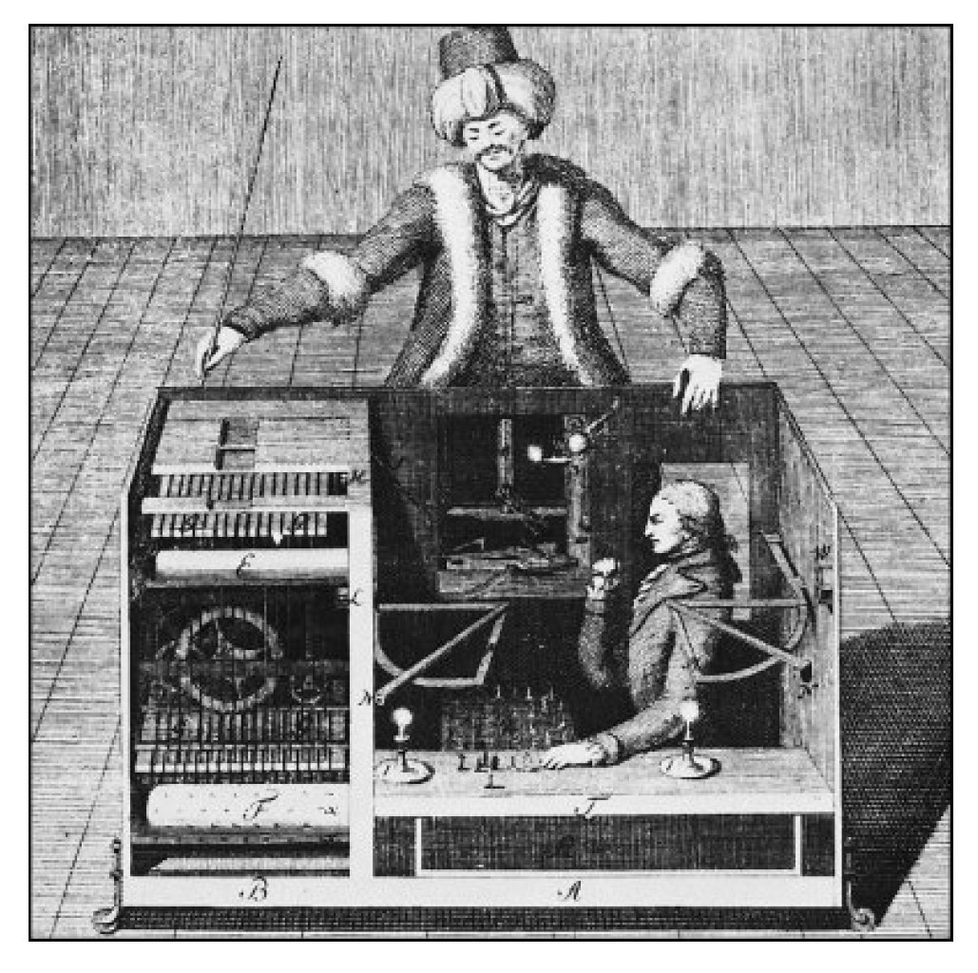
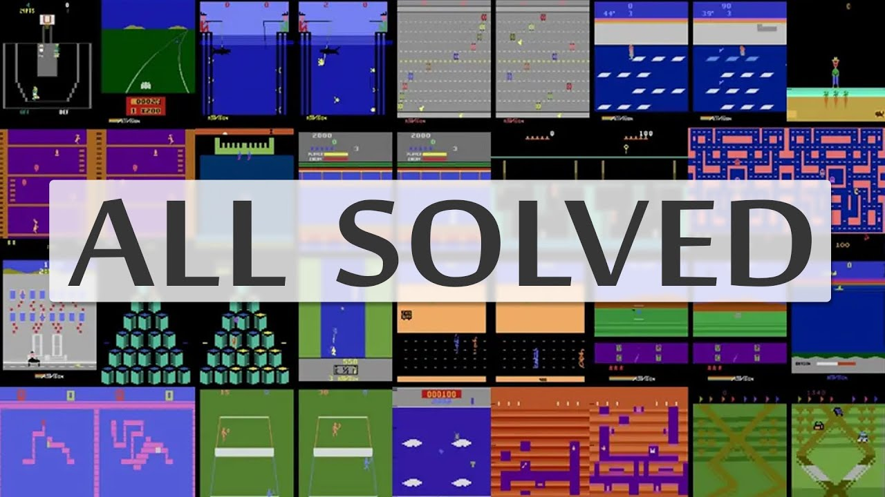
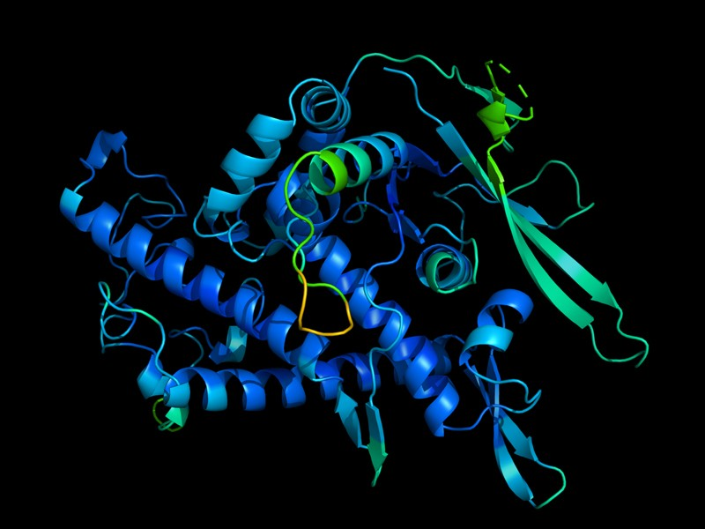
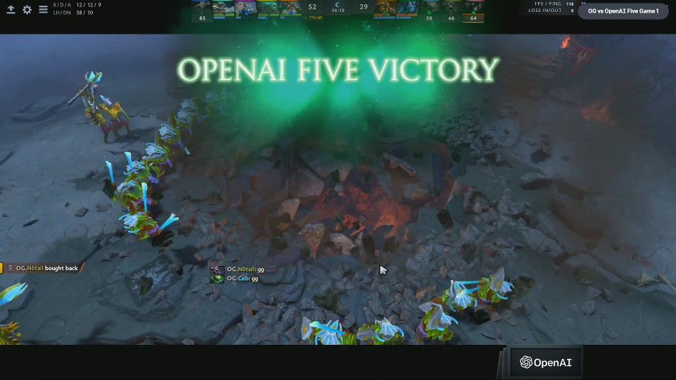
History of Game Machines
18th century: The Turk: Fake chess machine
1970ies: First chess programs
1997: Deep Blue beats chess world champion
2015: DeepMind solved all Atari Games (Agent 57)
2016: AlphaGo beats Lee Sedol in the Game of GO
2017: OpenAI wins Dota2 in 1on1
2019: OpenAI wins Dota2 in 5on5
2020 Deep Mind practically „solved“ Proteinfolding
despite beeing NP-Complete
Notes:
Could also be used for other NP complete problems as heuristic (e.g traveling salesman)

Slide 4
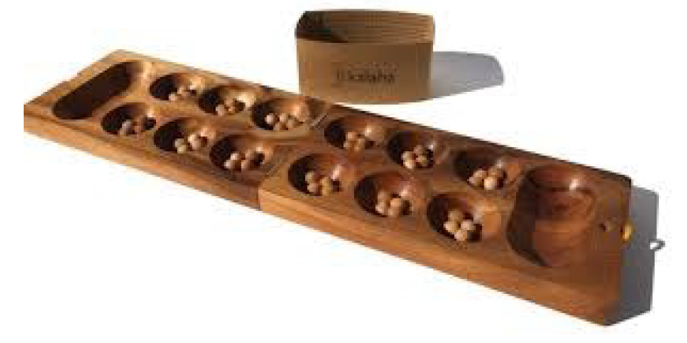
Lab Project
Students should be able to implement a Game AI for the Mancala Game Engine. (by Robert Fischer https://github.com/metzzo )
Agents will play against each other!

Slide 5
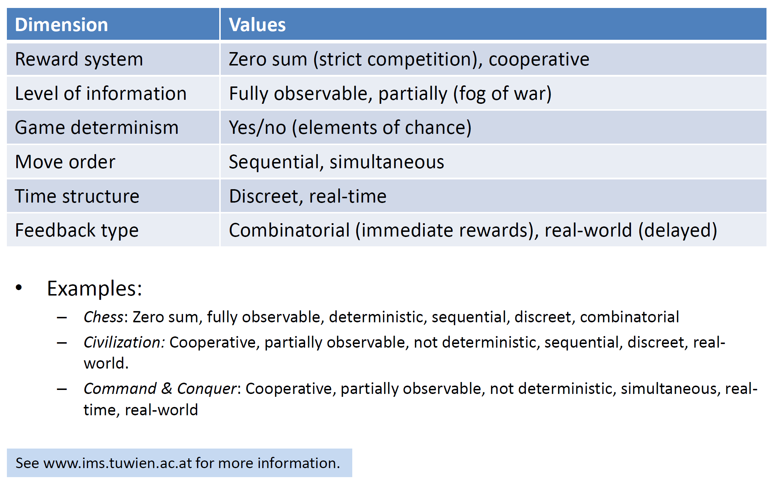
What Makes a Game?

Slide 6
Algorithmic Concepts & Terms
What makes a strategy?
Rules, freedom of choice, rewards for actions
Search strategies:
Dumb fast (e.g Minimax) -> Exhaustive tree search (trying out all moves)
Smart slow (e.g MCTS)
Search stability:
Fail hard: deterministic, stable, expensive
Fail soft: probabilistic, heuristic, unstable, cheaper

Slide 7
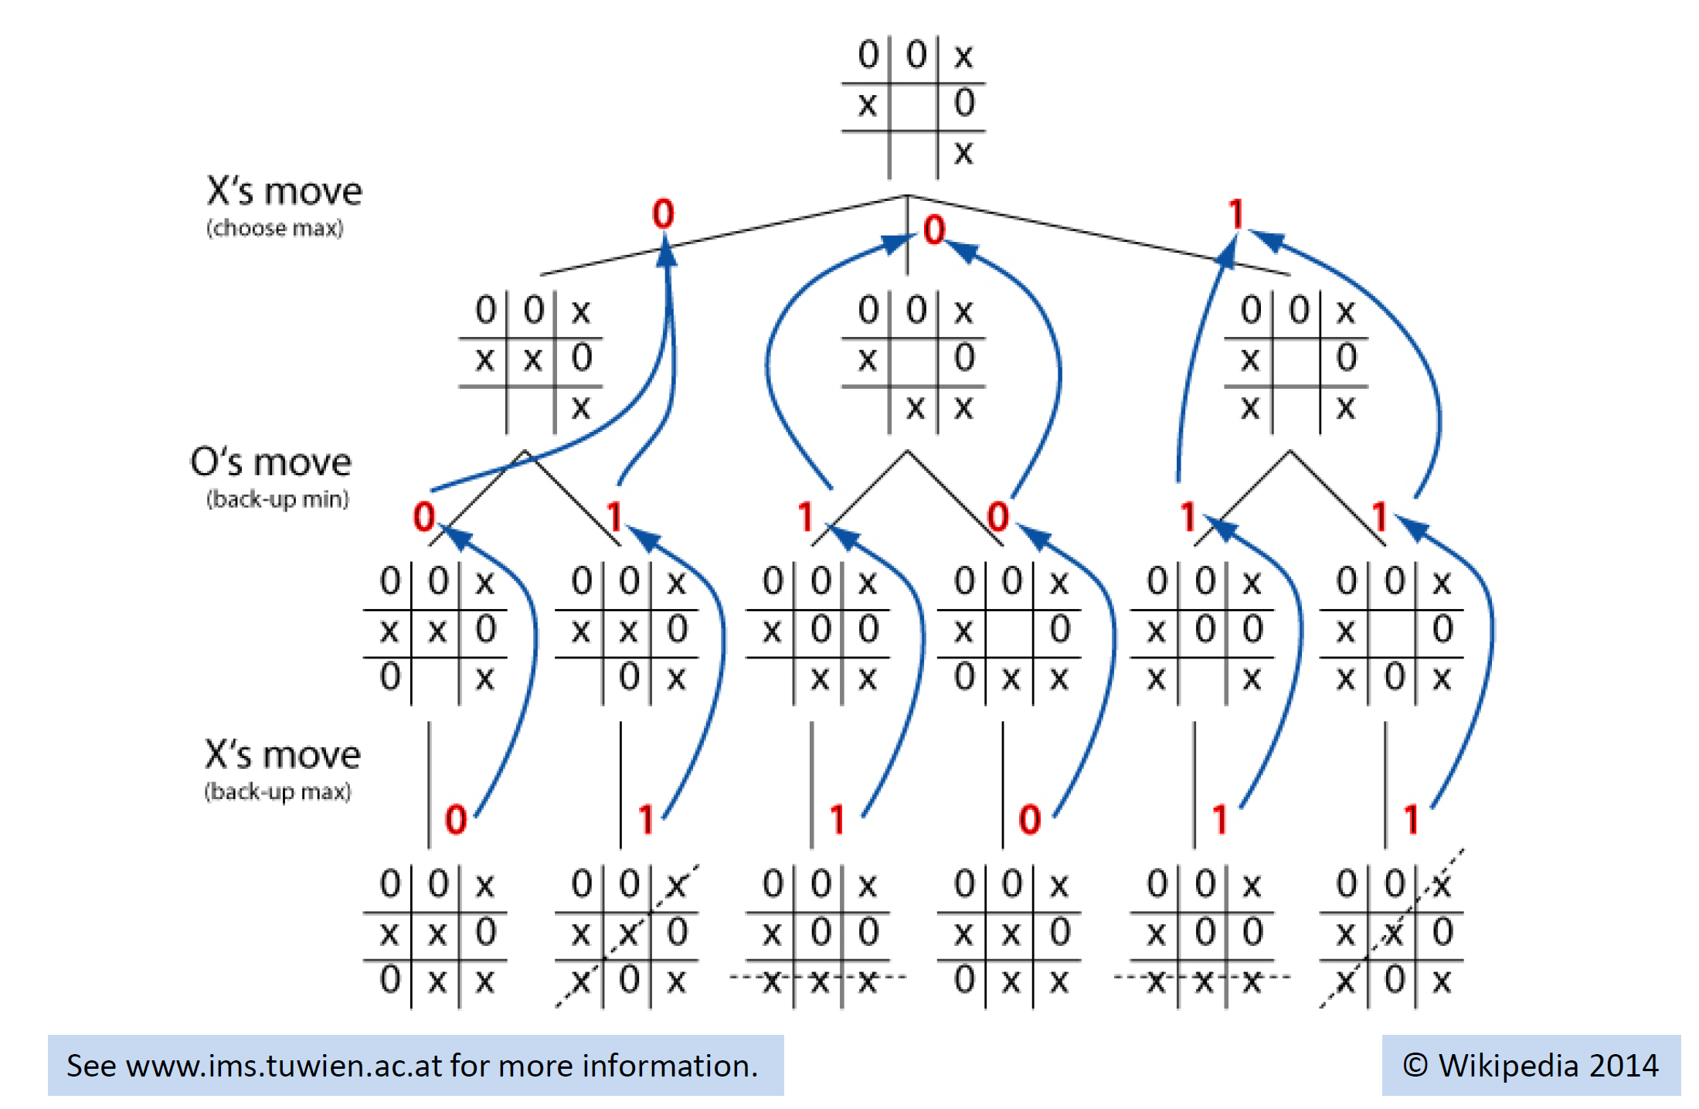
tic toe- Dumb Fast: Minimax Algorithm
Notes:
Game Trees are just trees, and nodes are game states.
Finding future positions that are favorable or unfavorible (e.g. number of chess elements on the board)
If the tree branches really wide, then the tree cannot be rolled out anymore,
That is the case of game of GO
Game of GO 10^170 states vs Chess 10^123 Sates

Slide 8
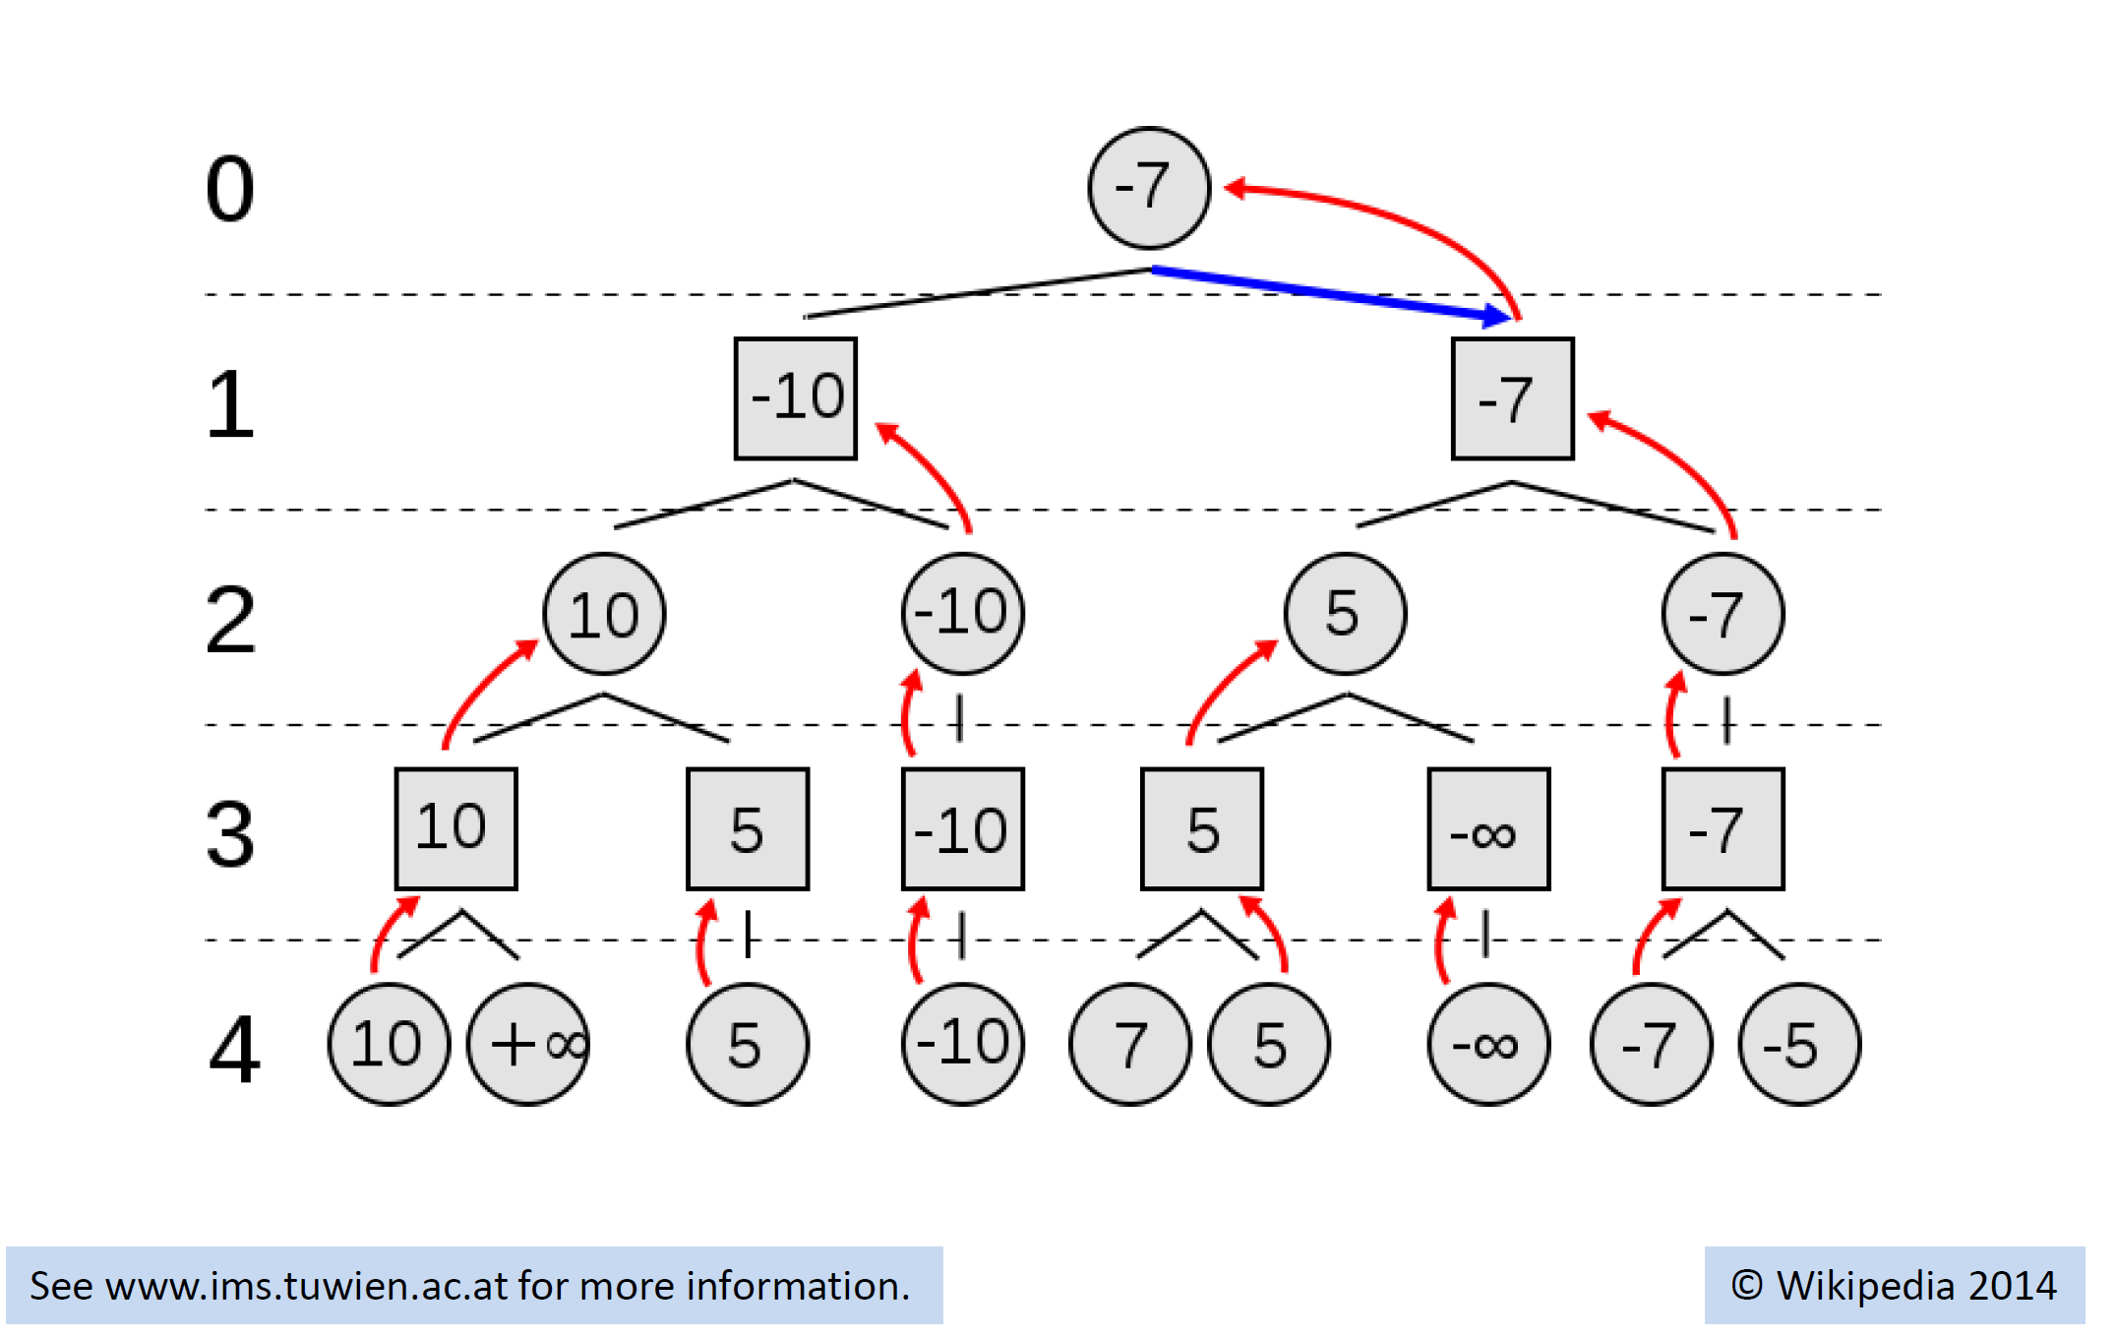
Numeric Example
Even Player always wants to maximize his reward
Odd Player always wants to minimize his reward
Actual Outcome for the even Player

Slide 9
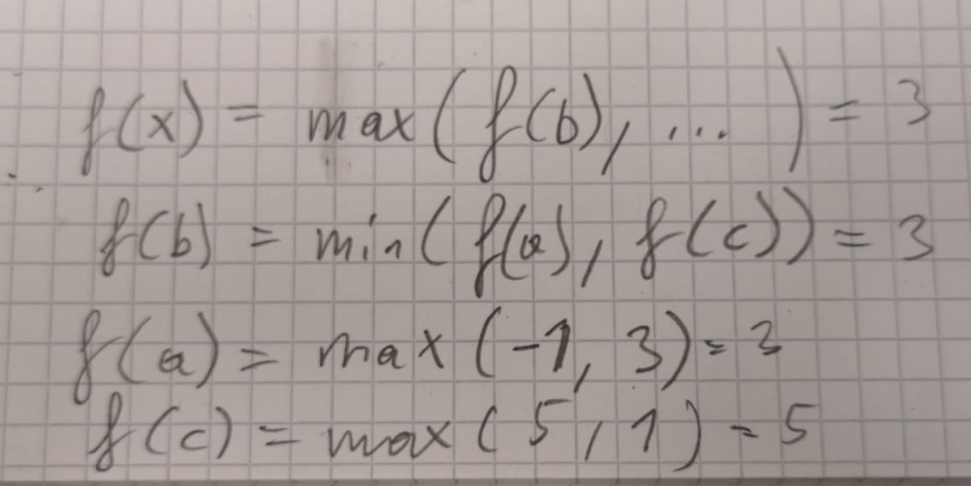
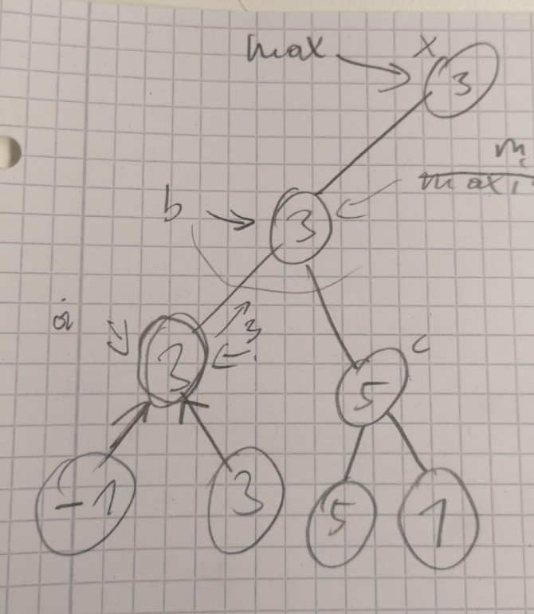
Minimax all you need is a recursive function f(gamestate,player) to evaluate the value of every move that is currently possible.
Anchor of the recursion when the leave node is reached (depthcounter = 0)
https://www.youtube.com/watch?v=l-hh51ncgDI&t=250s&ab_channel=SebastianLague
Notes:
man muss nur eine funktion f (gameposition, currentplayer) schreiben die jeweils alle moves in einer gameposition auswertet und dann je nach currentplayer das minimum oder das maximum der bewerteten moves zurückgibt.

Slide 10
Alpha Beta Pruning
Idea do not explore paths when the player in the current position would never go that way.
This can happen when doing the move would provide the opponent with a higher scoring move as already observed in the other branch.
https://www.youtube.com/watch?v=l-hh51ncgDI&t=250s&ab_channel=SebastianLague

Slide 11
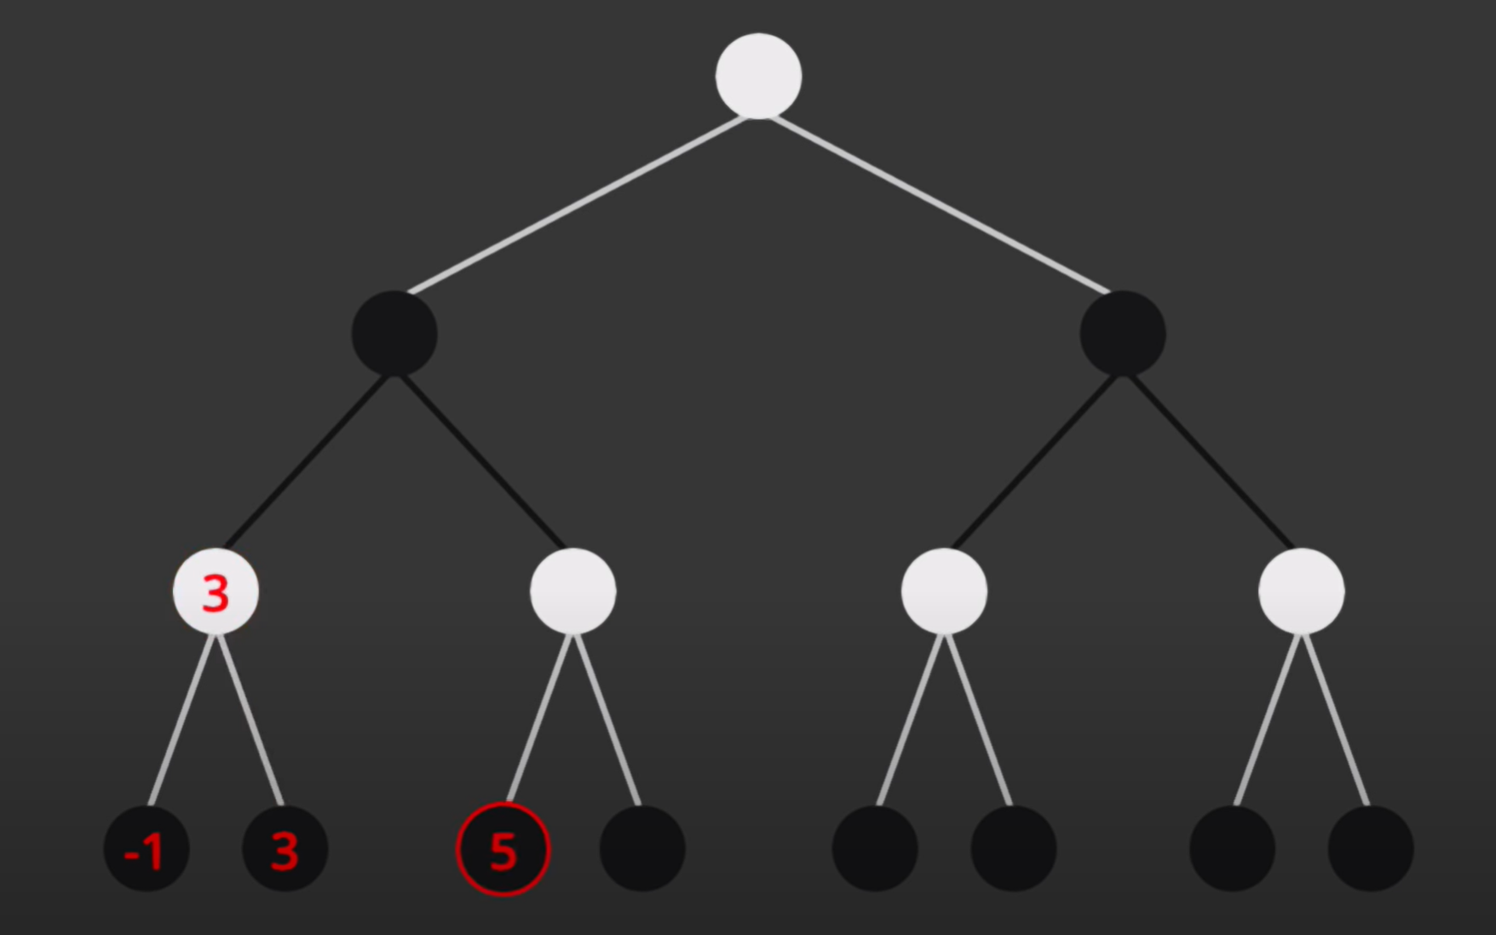
Alpha Beta Pruning
Not necessary to look into the right branch, since the black player would never choose it as It would give the white player the option for a higher reward
Minimizing
Long time the state of the art for chess, (using domain expert evaluation functions)

Slide 12
Problems in Case of
High Branching Factor (e.g Game of GO)
Missing Evaluation function

Slide 13
Monte Carlo Tree Search
MCTS creates a statistics tree (describing the value of a position)
Idea is to focus the search time to more relevant options.
It comes up with these values by simulating steps (first random later more exploiting)
Selection, Expansion, Simulation, Update -> https://www.youtube.com/watch?v=Fbs4lnGLS8M&ab_channel=FullstackAcademy
Open Ended Environments (no domain dependent evaluation function required)

Slide 14
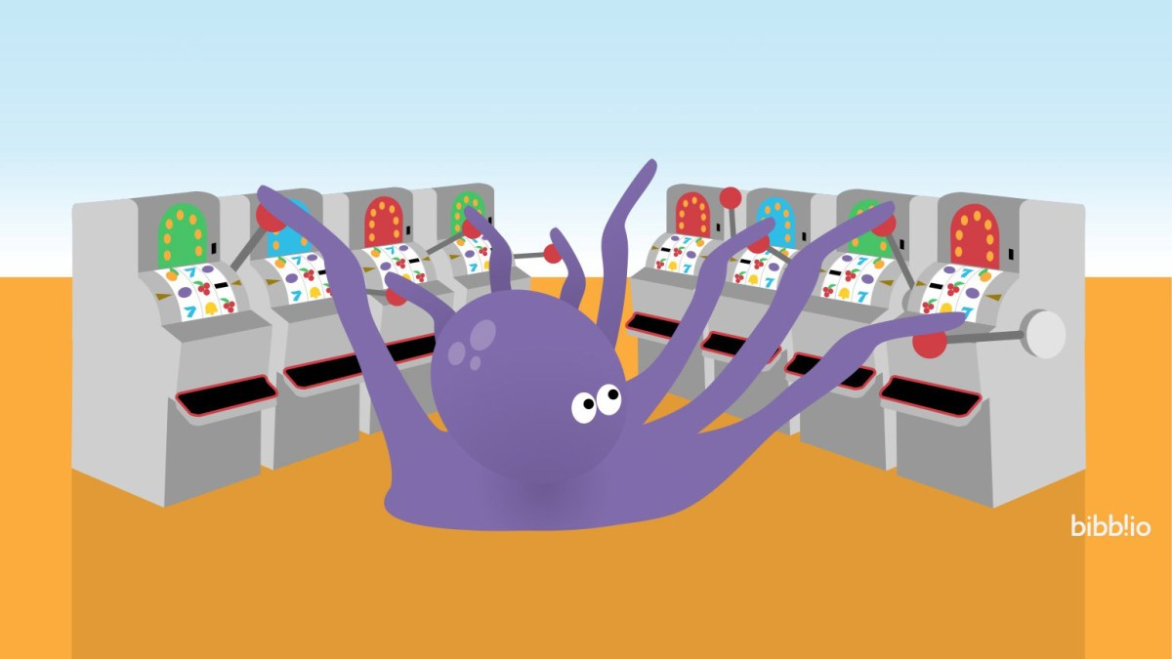
Bandit Based Methods
Exploration Only
Exploitation Only
Epsilon Greedy
https://www.youtube.com/watch?v=e3L4VocZnnQ&ab_channel=ritvikmath
Notes:
Exploration Only -> Pure Random
Exploitation Only -> Test each machine once, and then use only the machine with hightest reward on that run.
Epsilon Greedy (balance exploration vs exploitation, e.g Randomly Pick a machine in 10% of the cases, vs 90% picking the machine with highest mean reward so far.

Slide 15
Upper confidence bound, version 1) UCB 1 Strategy
When you are uncertain about your estimate of the value of a move.
At each Time t, Pick Move such that
Mü_r + sqrt(2ln(t)/N_t(r)) is maximized
Where mü_r is the expoitation and the rest is the exporation.
https://www.youtube.com/watch?v=FgmMK6RPU1c&ab_channel=ritvikmath
Notes:
When you are uncertain about your estimate of the value of a move.
At each timepoint t> you pick the restaurant r such that…
Benefit of the doubt, lets try a move again when not tried often.

Slide 16
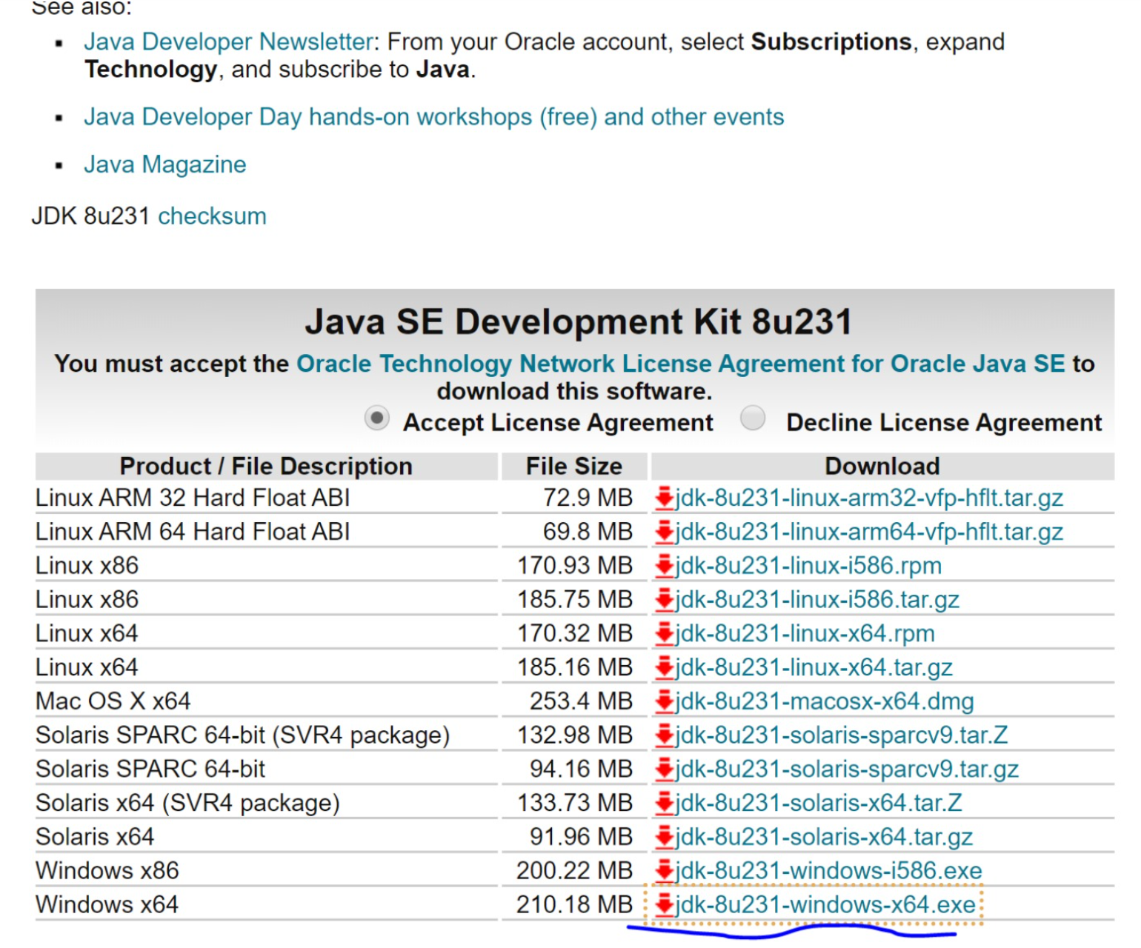
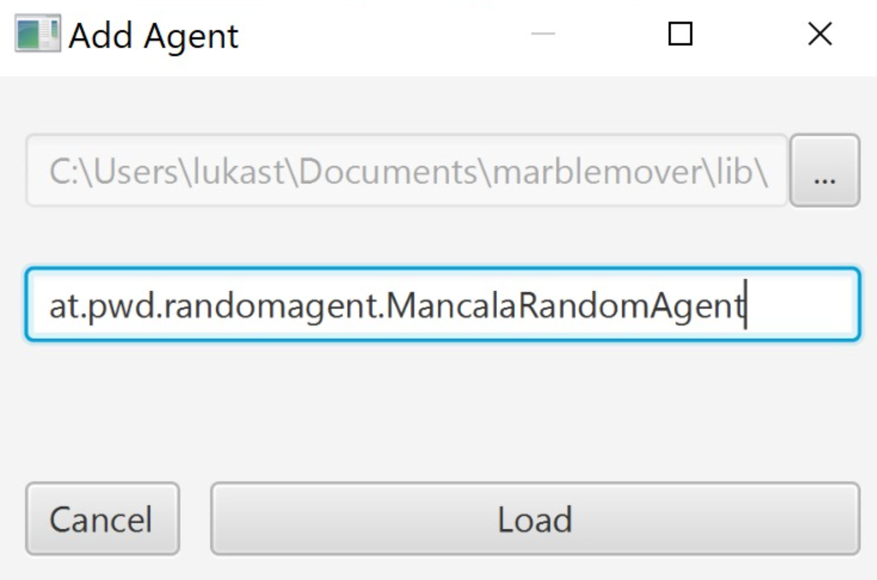
Game of Mancala
https://github.com/metzzo/mancala
Notes:
[08:44, 20.12.2019] Lukas Steindl: habs jetzt auf einem neuen rechner installiert und mal wieder a zeitl braucht bis es überhaupt lauft... zur Doku: man braucht unbedingt das JDK hier: und die JAVA_HOME variable muss auf das installationsverzeichnis dann zeigen exklusive \bin am ende[08:45, 20.12.2019] Lukas Steindl: bzgl. des problems dass er den agent nciht laden kann... ich hab die agent config ganz rauswerfen müssen um es überhaupt starten zu können... d.h im config file muss es zu beginn so aussehen:[08:45, 20.12.2019] Lukas Steindl: <config> <agents/> <computation-time>5</computation-time> <stones-per-slot>4</stones-per-slot> <slots-per-player>4</slots-per-player></config>

Slide 17
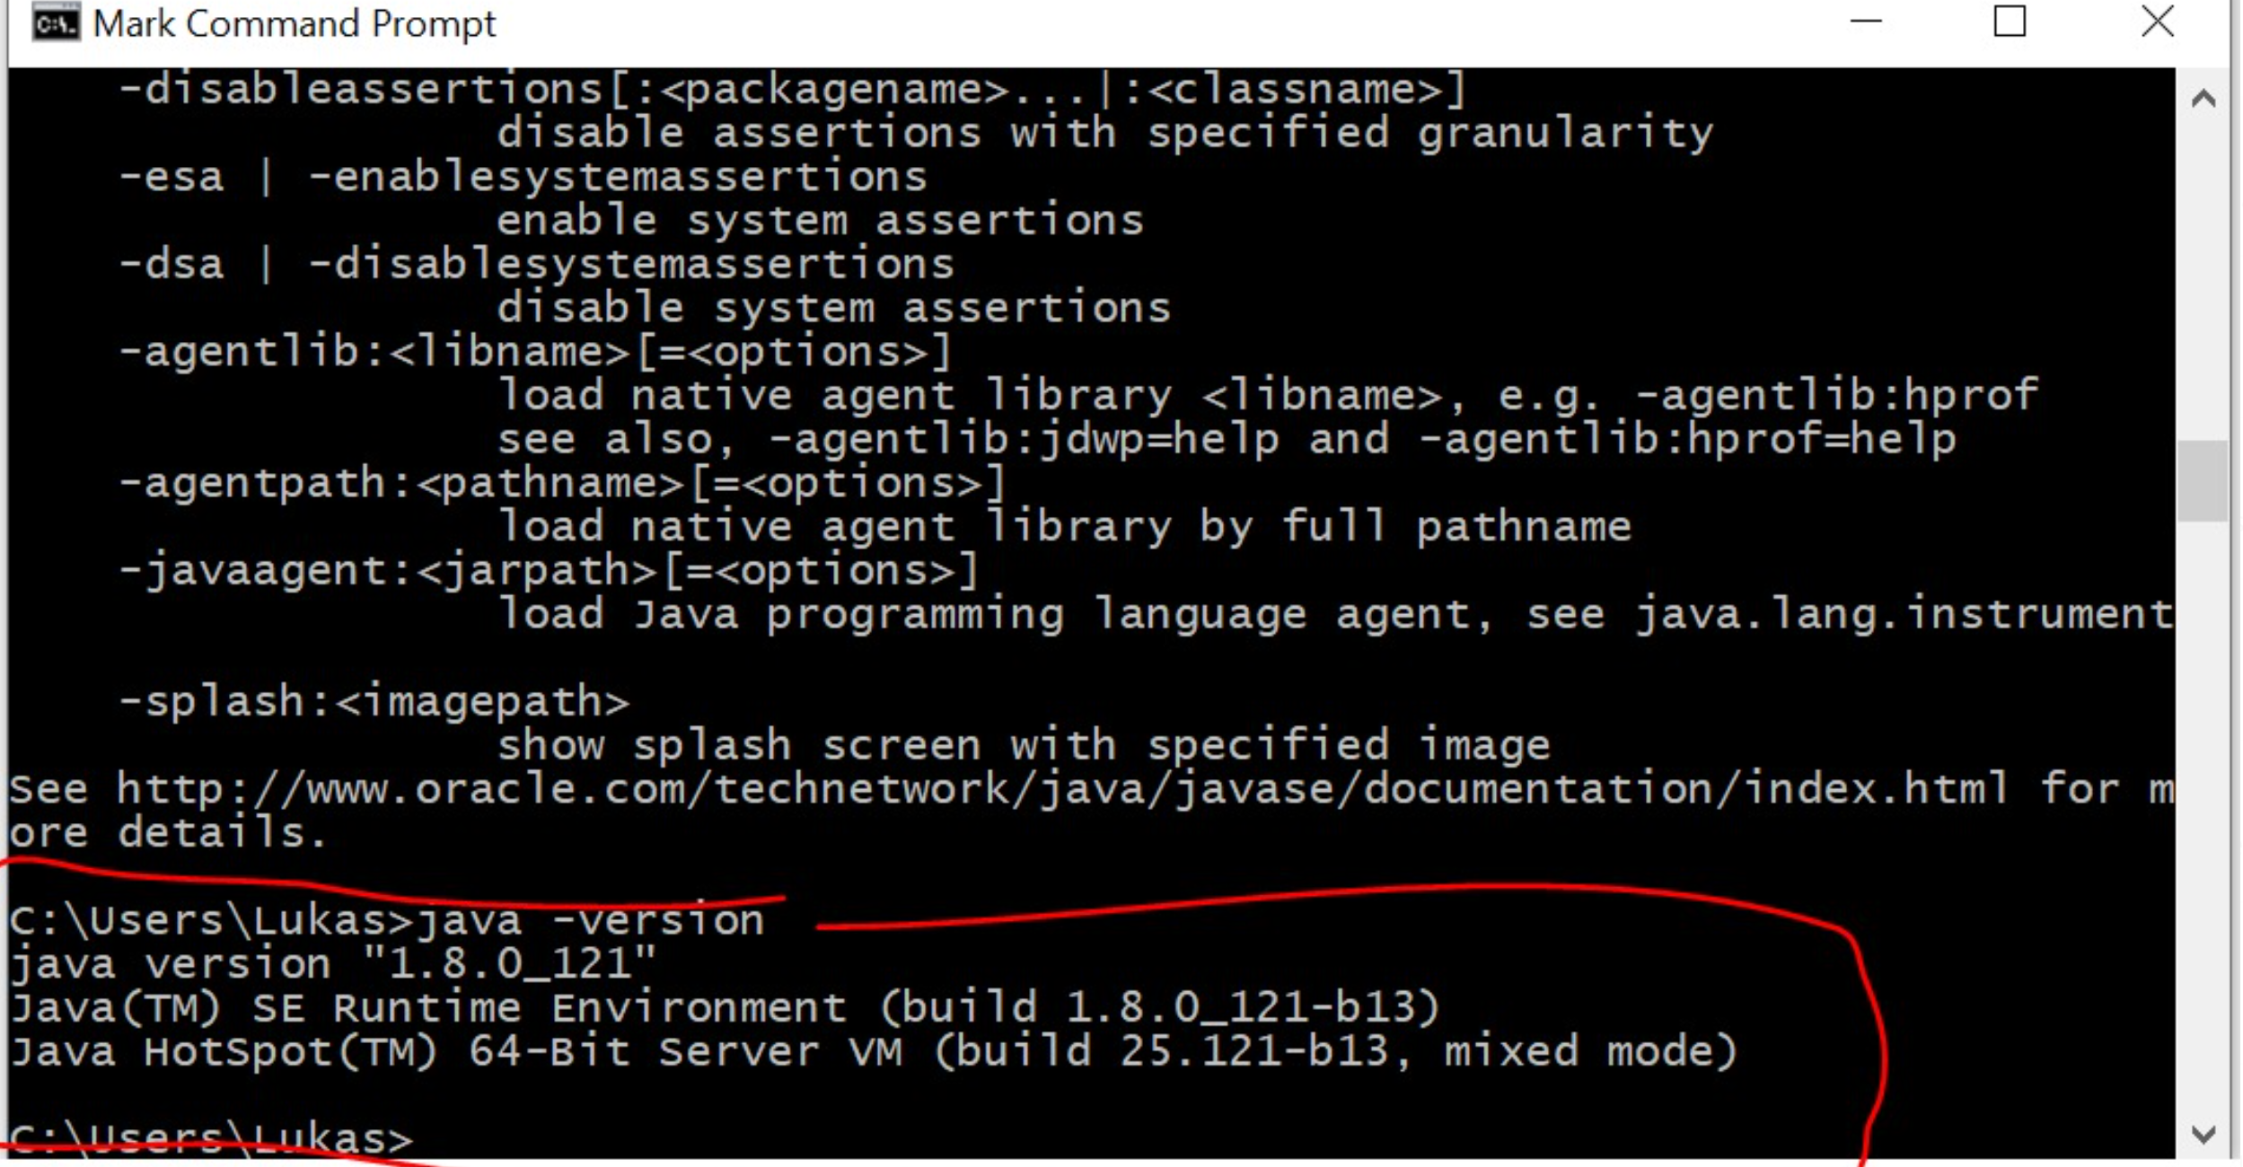
Notes:
Make sure classpath is set so that windows finds java.exe

Slide 18
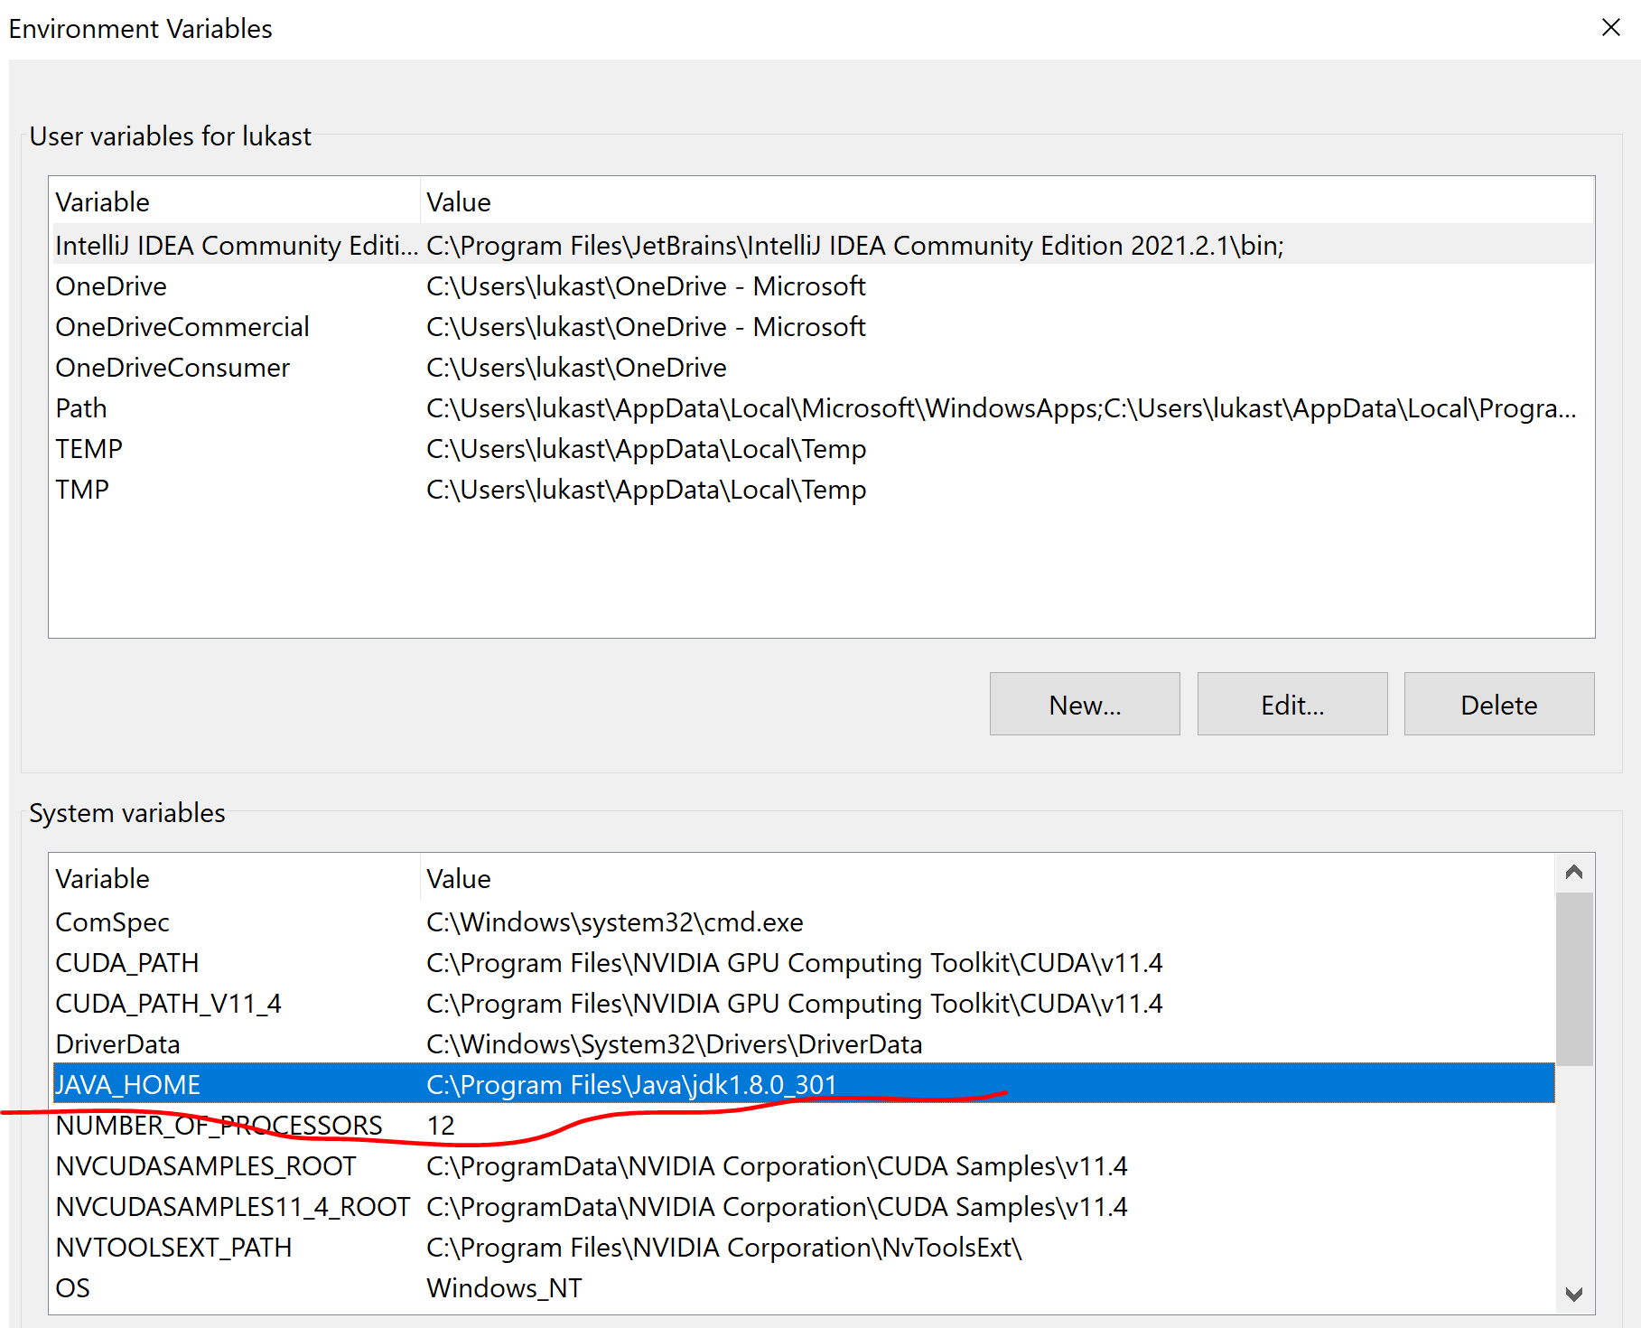
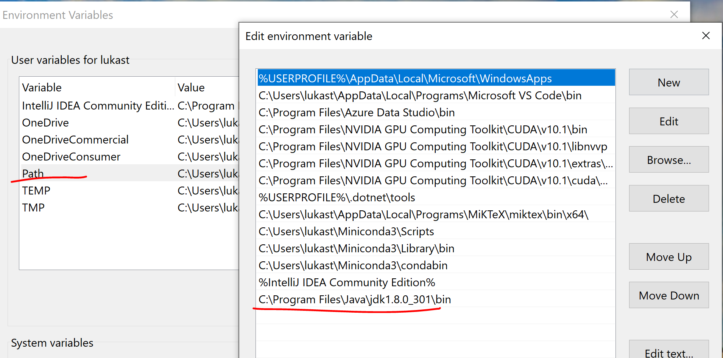
Environment Config

Slide 19
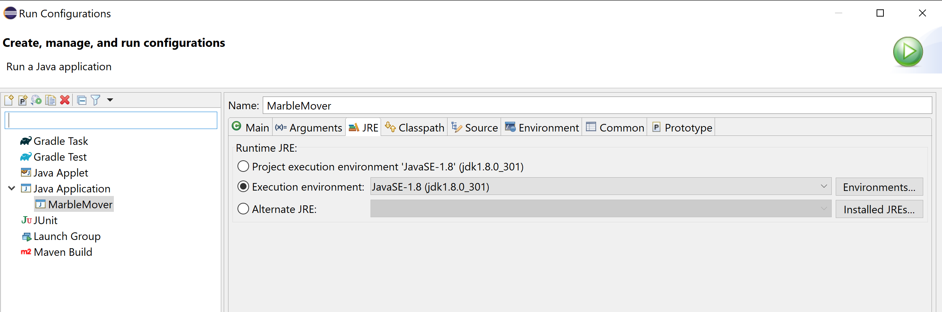
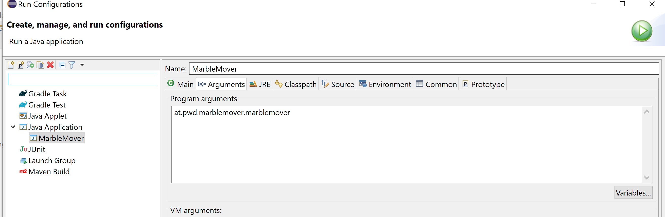
Eclipse Run Configuration

Slide 20
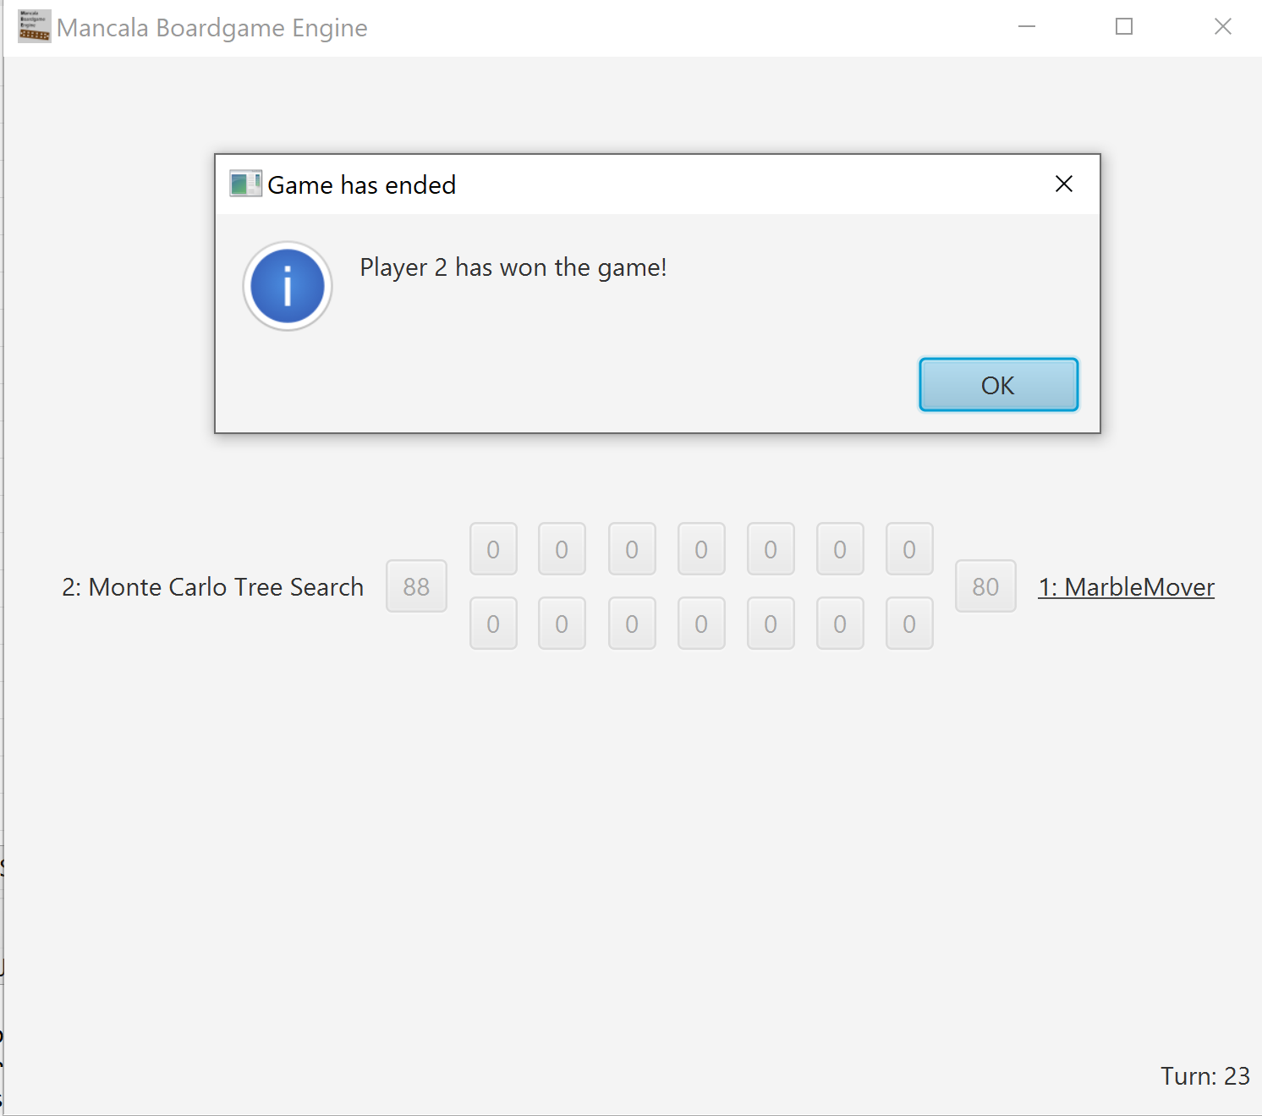
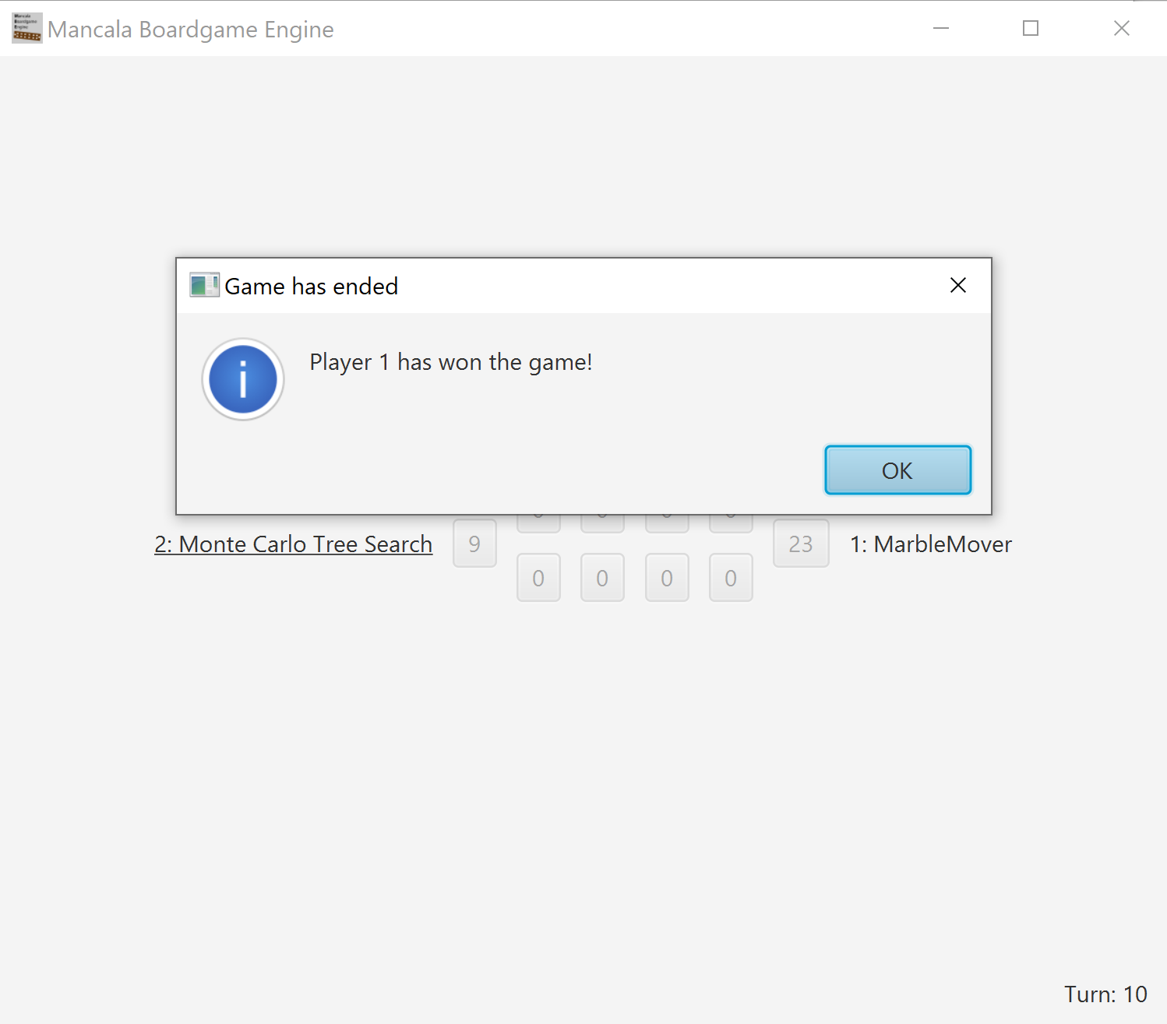
Example Play

Slide 21
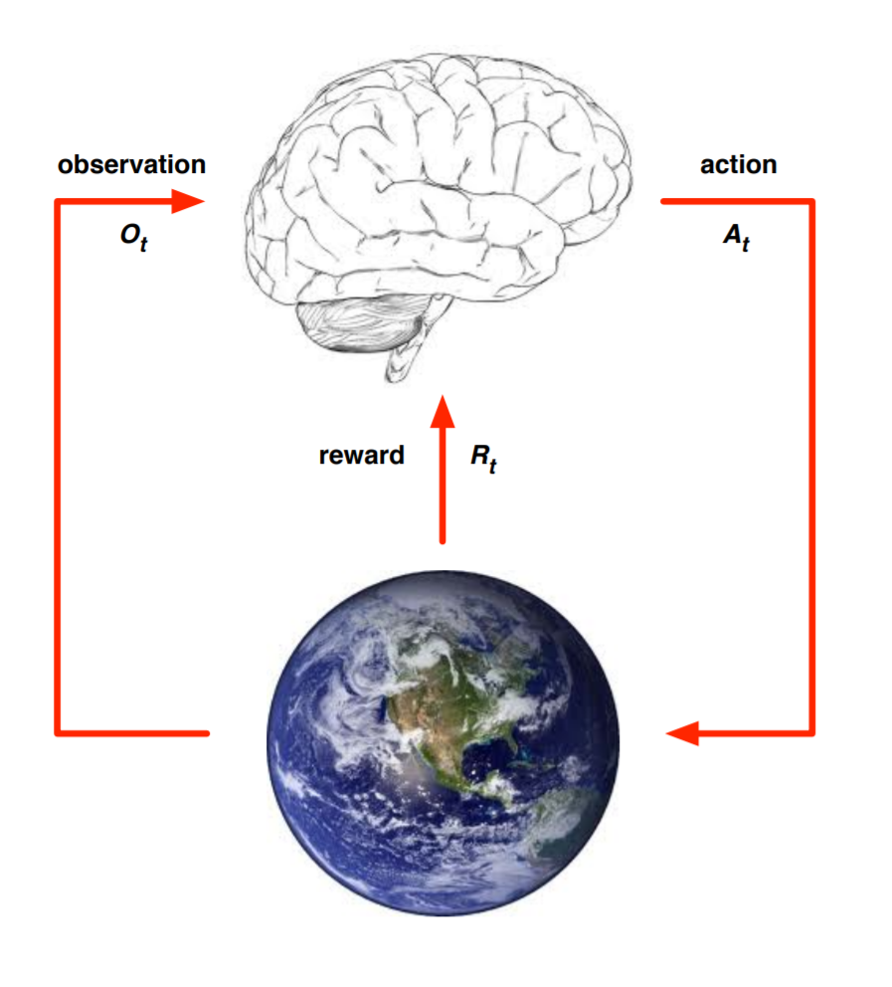
Reinforcement Learning
https://www.davidsilver.uk/wp-content/uploads/2020/03/intro_RL.pdf

Slide 22
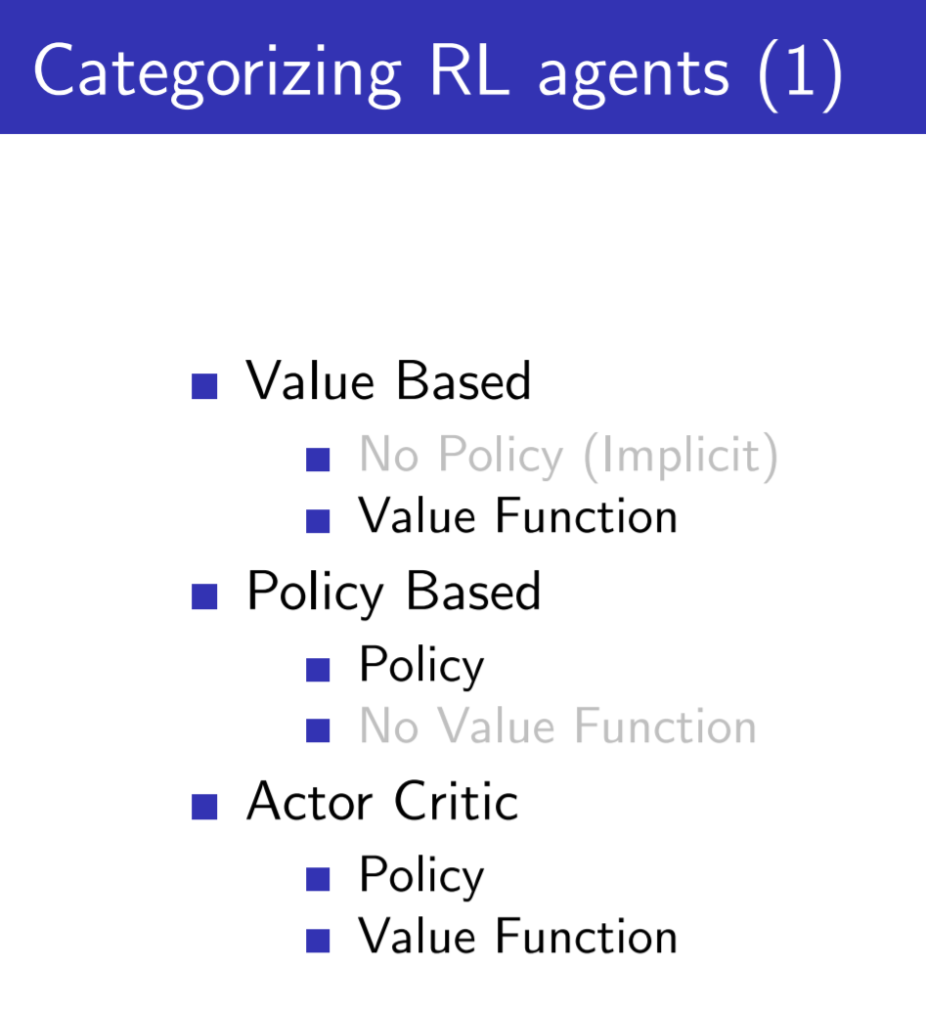

Slide 23
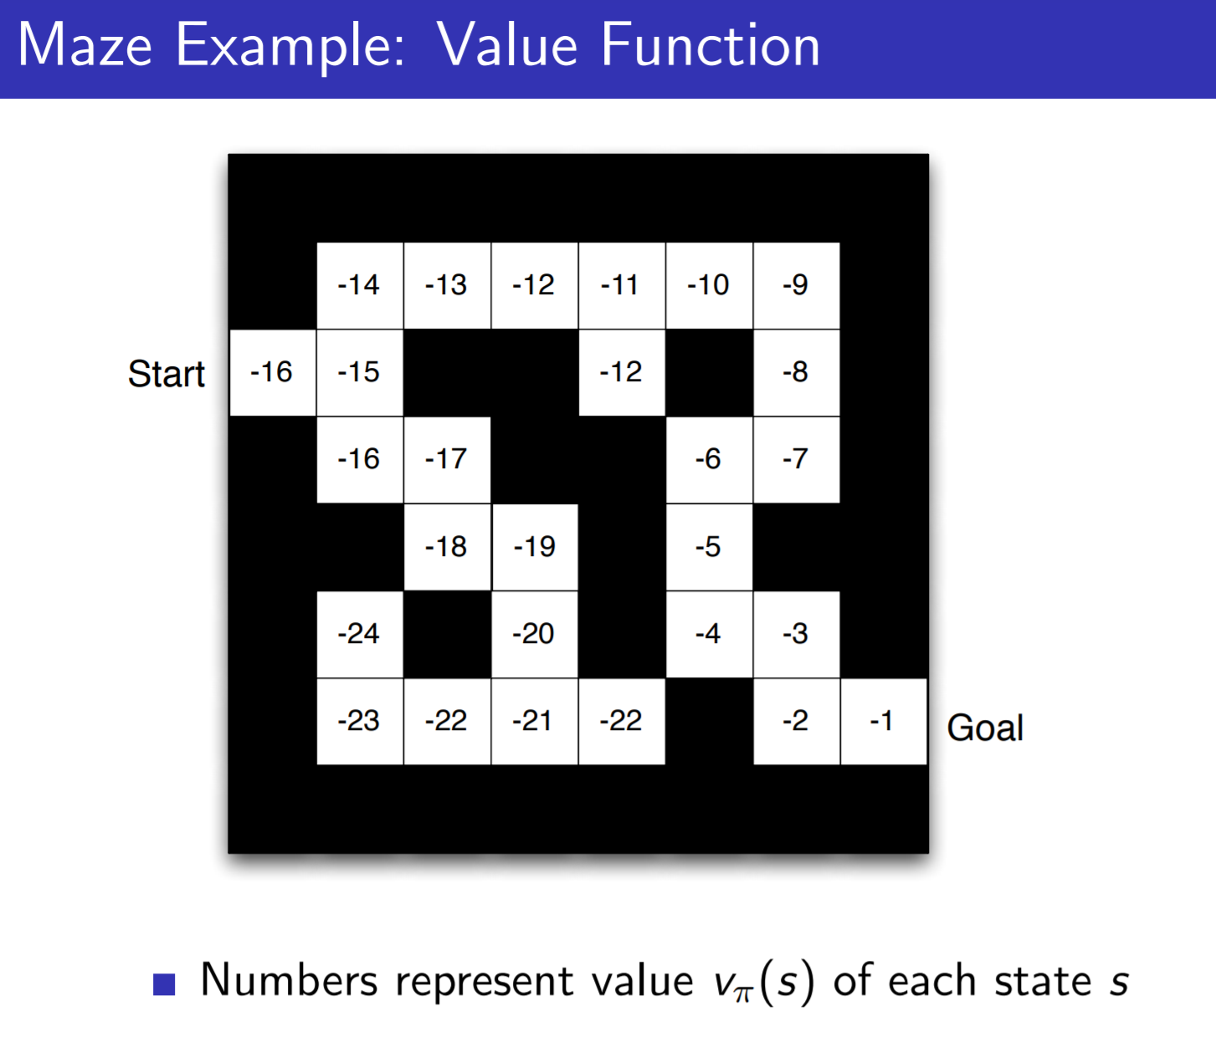

Slide 24
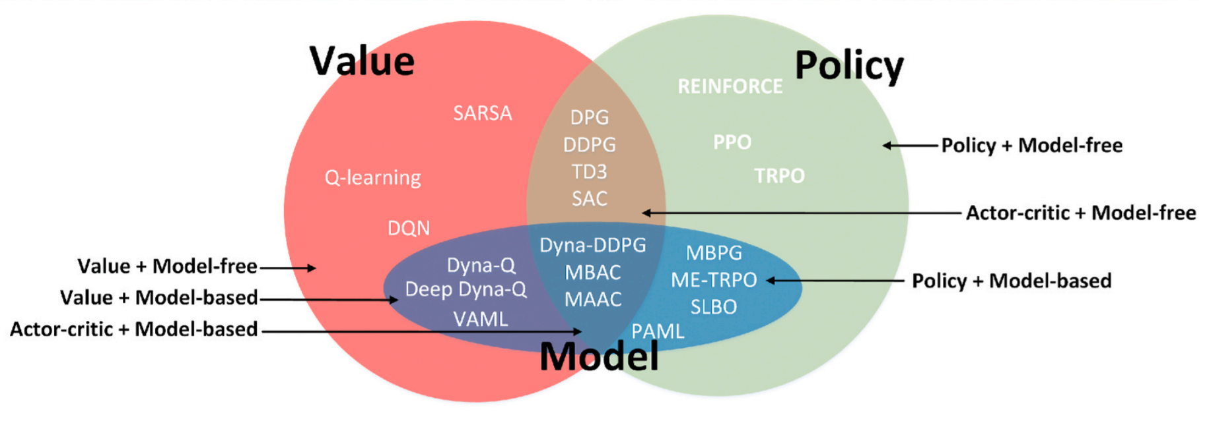
Reinforcement Learning
Policy based is better in case of broken Markov property.
Value based is often more sample efficient (not necessarily more computationally efficient)
https://www.davidsilver.uk/wp-content/uploads/2020/03/pg.pdf
https://www.youtube.com/watch?v=KHZVXao4qXs&ab_channel=DeepMind

Slide 25
Model Based vs Model Free
Model Free
-> Directly Predicting the Action from the Observation
Used in complex (also stochastic environments)
Model Based
-> tries to predict the next observation and reward, (often multiple times) and then decides what action to take
Used in deterministic environments

Slide 26
Policy Based vs Value Based
Policy Based -> Predicting a probability distribution over the next actions
Value Based -> Predicting the value of the next action

Slide 27
On-Policy vs Off-Policy
On Policy – directly learning from the environment
Off Policy -> Learning from historical data e.g obtained by a previous version of the agent, or human recorded.)

Slide 28
Cross Entropy Method
Play N episodes using the current model and environment
Calculate reward for every episode
Keep only the top 70% of the episodes by reward
Train neural net on these “elite” episodes taking state as input and action as output.
Repeat till convergence

Slide 29
REINFORCE
https://medium.com/@thechrisyoon/deriving-policy-gradients-and-implementing-reinforce-f887949bd63

Slide 30
AlphaGo
Policy Network to predict potential moves (Reducing the breadth of the search tree)
Value Network to predict the outcome of the game (reducing the depth of the search tree)
Deepmind AlphaZero - Mastering Games Without Human Knowledge - YouTube

Slide 31
AlphaGo Zero
Only One Network trained using self play
No Random MCTS Rollouts (Problems occur if random rollouts often lead to wins by accident you start to believe certain positions are very effective)
Single Network guides the MCTS Algorithm, suggesting moves -> then play that move run another search(using the model and so on... Till game is completed.
Then they trained a policy network P‘ to predict what the MCTS would have produced.
Also trained a new value network V‘ that predicts the winner based on the board
Search based policy iteration (policy improvement , policy valuation) Alternate between the stages gives you stronger and stronger policies.
Critical Success Factor: Search based policy evaluation! (testing a new policy by seeing what the value is when playing it to the end)
Deepmind AlphaZero - Mastering Games Without Human Knowledge - YouTube

Slide 32
Alpha Zero
Works similar to the human way of playing … looking at promising moves (simulating the next steps) ignoring obviously bad moves.
Value Network -> Takes Game State as Input -> outputs value of that state. Very simple function approximation from sequences.
Policy Network -> trained such that the output is the same as MCTS
MCTS uses Policy Network to determine which positions are promissing
Notes:
https://www.youtube.com/watch?v=MPXGiowUr0o&ab_channel=SkowstertheGeek
https://www.youtube.com/watch?v=62nq4Zsn8vc&ab_channel=JoshVarty

Slide 33
Development Environment Options
Directly on your Windows Desktop Client
Azure Data Science VM
Docker
Azure ML
C:\Users\lukast\Documents\mln
Windows /Linux Dual Boot
Linux Subsystem -> just no
Notes:
Docker -> Resource Intensive & Slow -> GPU Configuration may take ages!
Directly on Windows Desktop Client -> big issues with Gym Framework
Azure ML -> Black Box (uses Docker in the background) 3 Month tutorial fails without error message -> some trial & error to identify again that the docker environment causes problems.
Azure Datascience VM -> simples Option for Learning Purpose (Downside -> fast aging image (many libraries update frequently) – often easier to create a new vm after a while than patching the existing one.

Slide 34
Game Environments: Gym
Open AI Framework
Atari Games
Classic Control problems -> good for testing
Board Games
...
Notes:
https://gym.openai.com/
Install with
pip install gym
pip install keras

Slide 35
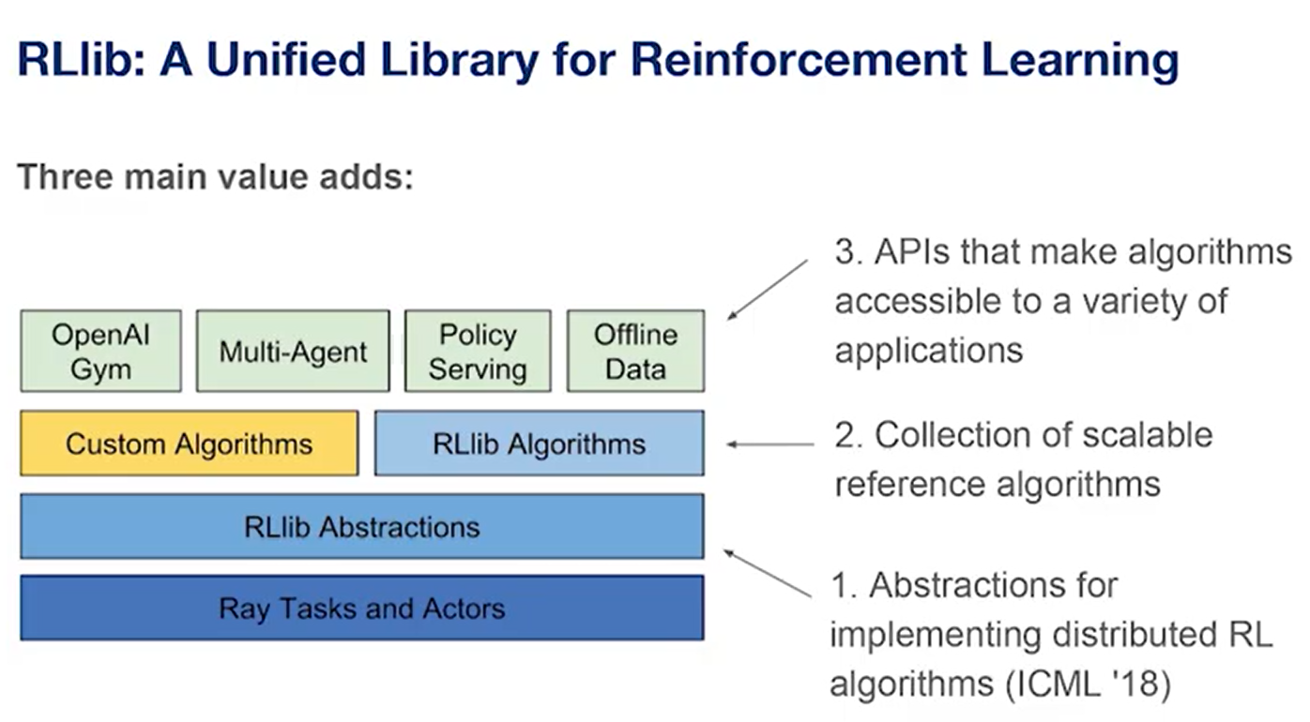
RAY
https://www.youtube.com/watch?v=8tG8PJC6oaU&ab_channel=AICamp

Slide 36
Deep Learning
Hier das Beispiel mit Gradient Descent raussuchen (Deep learning for Vision)

Slide 37
Custom Environments
RLlib Environments — Ray v2.0.0.dev0

Slide 38
https://techcommunity.microsoft.com/t5/azure-ai/introducing-reinforcement-learning-on-azure-machine-learning/ba-p/1403028
https://github.com/Azure/MachineLearningNotebooks/tree/master/how-to-use-azureml/reinforcement-learning
https://github.com/ray-project/ray
http://karpathy.github.io/2016/05/31/rl/
https://cs.stanford.edu/people/karpathy/reinforcejs/gridworld_dp.html

Slide 39
Issues I ran into
For the cartpole rl on sc demo I had some missing python packages in the docker image (resulting in an error when trying to capture the video) -> fixed this in a fork of the repo and created pull request
Missing Azure CLI for the Atari Distributed pong Demo
Install the Azure CLI for Windows | Microsoft Docs

Slide 40
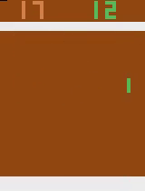
Pong

Slide 41
Pong
File "/opt/miniconda/lib/python3.7/site-packages/tensorflow/python/client/session.py", line 1149, in _run
str(subfeed_t.get_shape())))
ValueError: Cannot feed value of shape (4, 4, 4, 16) for Tensor 'default_policy/Placeholder_default_policy/conv1/kernel:0', which has shape '(8, 8, 4, 16)'
2021-08-25 15:51:15.470861: CPU Usage: 24.1%, Memory Usage: 6.0%, Memory Total/Available: 59074052096/55516184576
[2m[36m(pid=147)[0m /opt/miniconda/lib/python3.7/site-packages/tensorboard/compat/tensorflow_stub/dtypes.py:541: FutureWar

